Slide 1



Olympic Athlete Analytics Pipeline
From Data Extraction to Insight-Driven Decision Making
1
Data Querying
2
Data Processing
3
Visualization
4
Storytelling
Power Bi
Power Bi
Power
Point
From My PC
Power Point
Local SQL
BigQuery
BigQuery
Local SQL
Development
BigQuery
Cloud Data Warehouse
SQL Processing
Power BI
Data Modelling
Dashboard Visualization
PowerPoint
Executive
Presentation
Dataset: Olympic Athlete Events (1896-2016)
Project: Olympic Athlete Performance Analysis

Slide 2
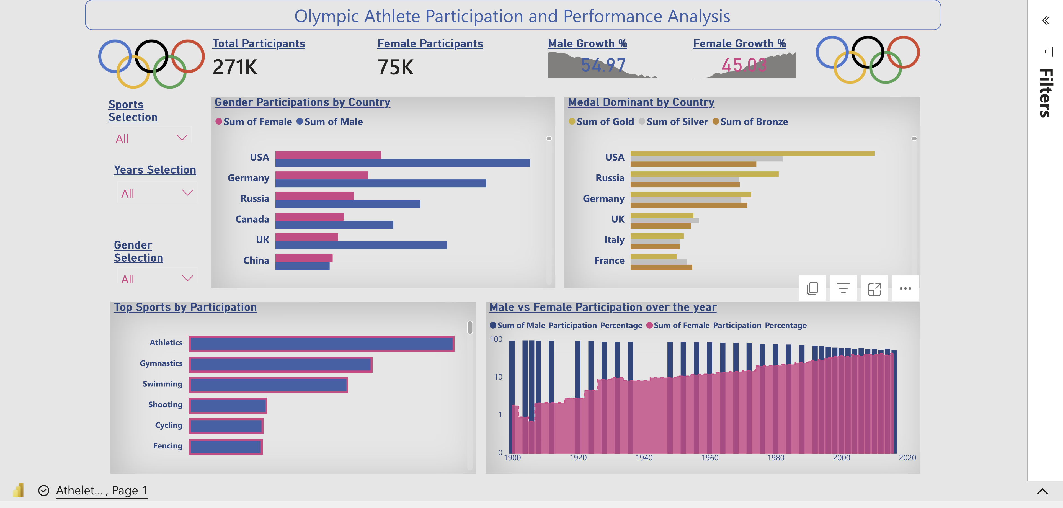
Power BI Dashboard Preview
Note:
The interactive Power BI dashboard is available when connected through Power BI Service. Due to student subscription limitations, this presentation contains a static dashboard preview.
The full interactive version can be explored through the Power BI (.pbix) file included with this project.
Interactive Dashboard Available In:
Power BI (.pbix) File
GitHub Repository
Notes:
Note:
The interactive Power BI dashboard is available when connected through Power BI Service. Due to student subscription limitations, this presentation contains a static dashboard preview.
The full interactive version can be explored through the Power BI (.pbix) file included with this project.

Slide 3

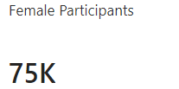
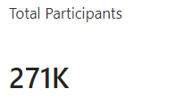
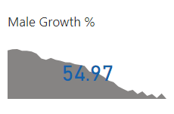
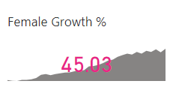
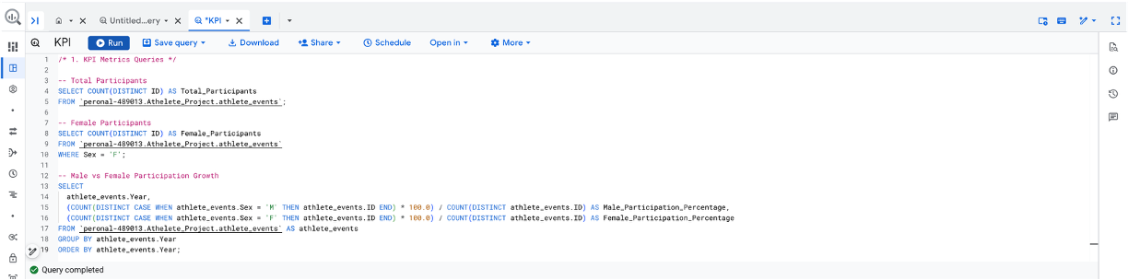
Olympic Athlete Participation Overview
Power Bi
BigQuery
Power Bi
Total Athlete
Key Insights :
Olympic participation has grown significantly since 1896
Female athlete participation has steadily increased
Gender balance has improved in modern Olympic Games
Participation growth reflects expansion of global sports

Slide 4
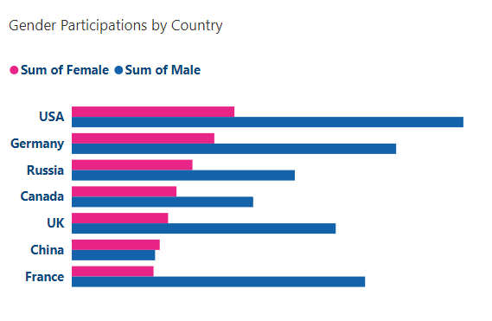
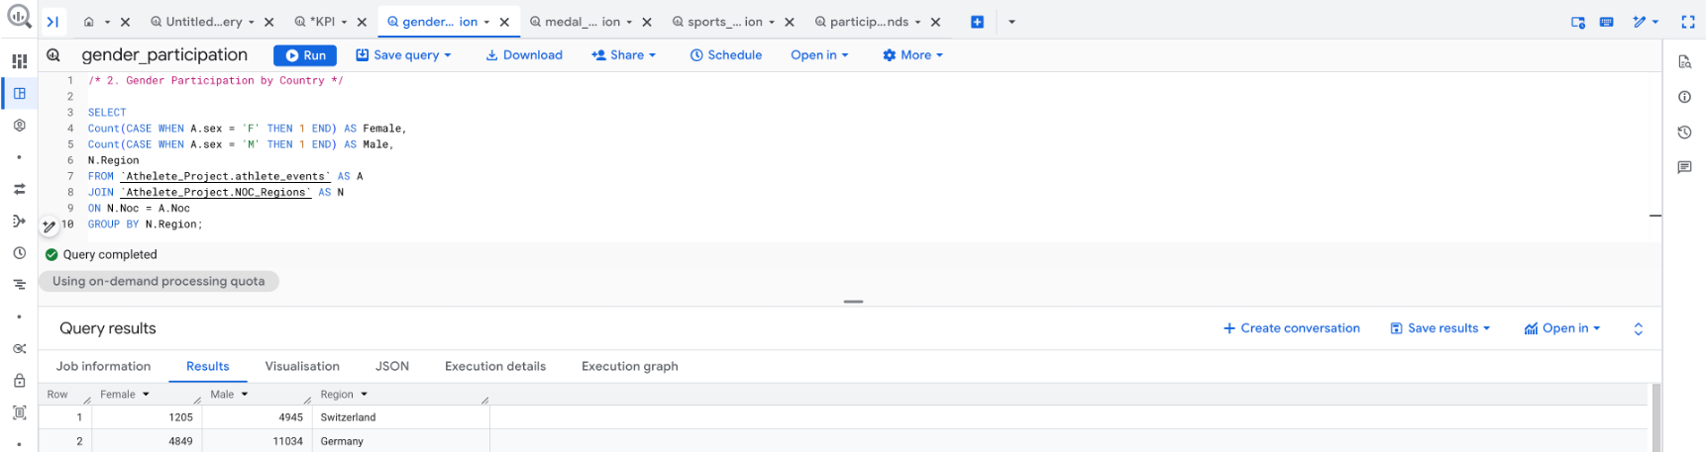
Gender Participation by Countries
Power Bi
BigQuery
Power Bi
Key Insights :
Female participation has increased dramatically after 1980.
Modern Olympic Games show stronger gender representation.
Gender equality initiatives are visible in recent Olympic cycles.

Slide 5
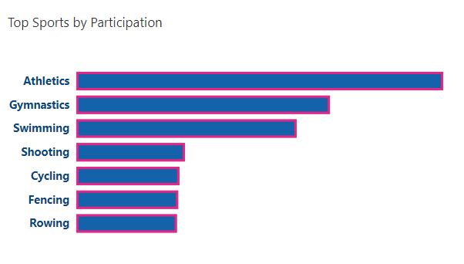
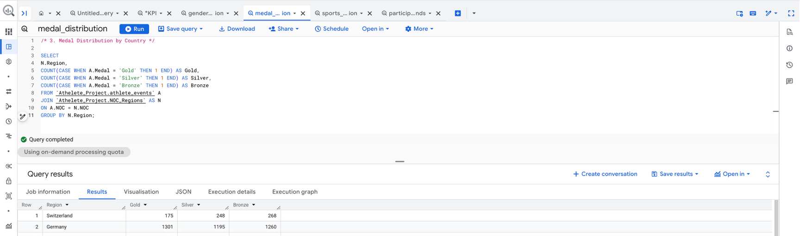
Sports with Highest Athlete Participation
Power Bi
BigQuery
Power Bi
Key Insights :
Athletics, Gymnastics, and Swimming attract the most athletes.
Multi-event sports drive higher participation.
These sports represent the core of Olympic competitions.

Slide 6
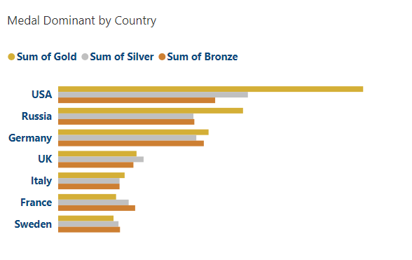
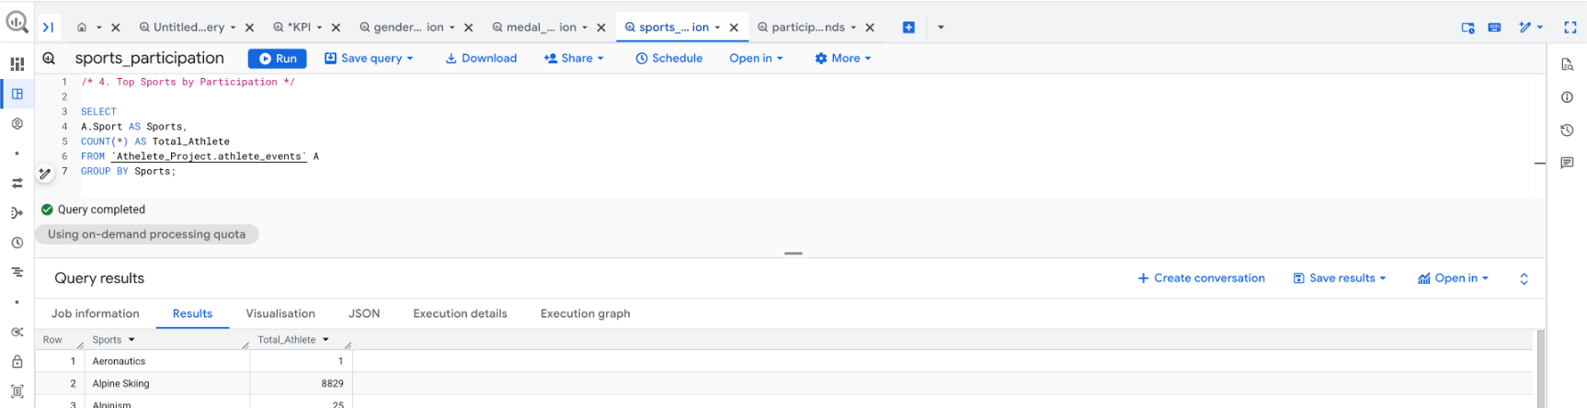
Global Medal Distribution
Power Bi
BigQuery
Power Bi
Key Insights :
USA, Russia, and Germany dominate Olympic medal counts.
Developed sports ecosystems contribute to consistent performance.
Regional sports investment influences medal outcomes.

Slide 7
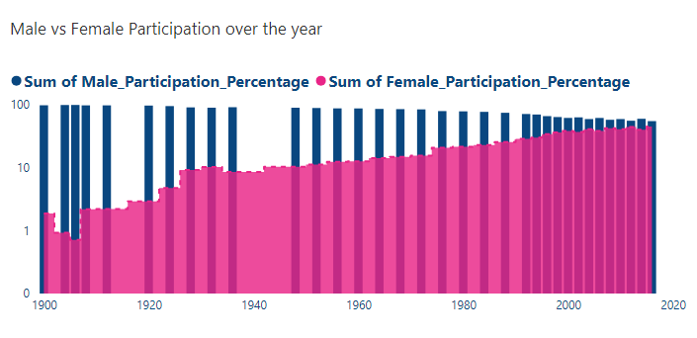
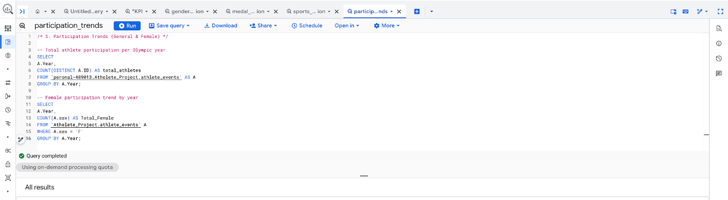
Female Participation Growth
Power Bi
BigQuery
Power Bi
Key Insights :
Female athlete representation has increased across Olympic years.
Policy changes and expansion of women’s events influenced growth.
Gender balance is improving in global sports participation.

